Slide 1
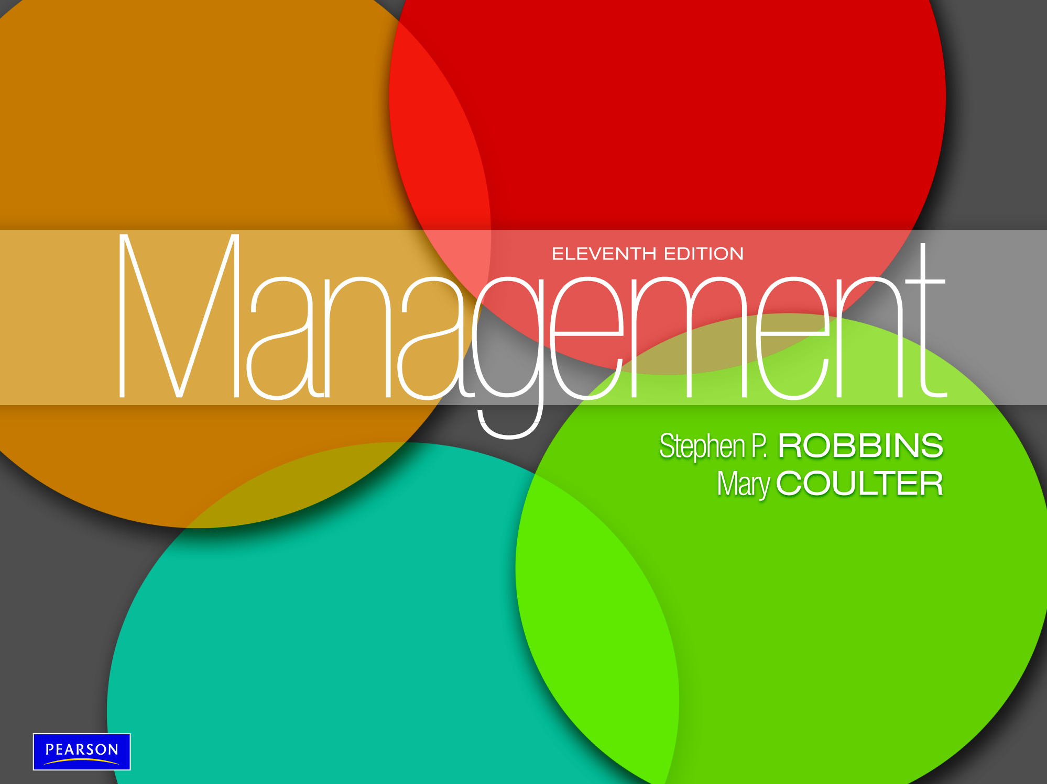

Slide 2
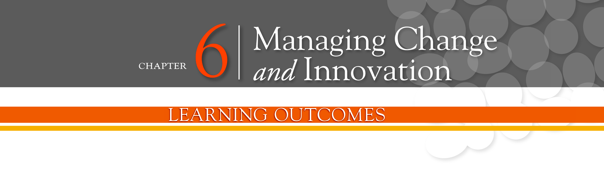
Compare and contrast views on the change
process
Classify types of organizational change
Explain how to manage resistance to change
Discuss contemporary issues in managing
change
Describe techniques for stimulating innovation

Slide 3
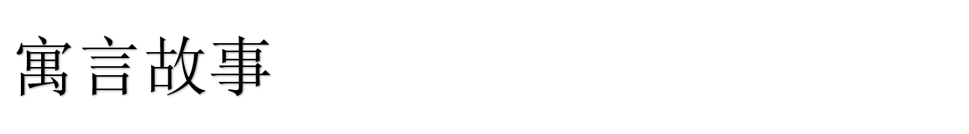
一天猎人带着猎狗去打猎。猎人一枪击中一只兔子的后腿，受伤的兔子开始拼命地奔跑。猎狗在猎人的指示下也是飞奔去追赶兔子。
可是追着追着，兔子跑不见了，猎狗只好悻悻地回到猎人身边，猎人开始骂猎狗了：“你真没用，连一只受伤的兔子都追不到！”猎狗听了很不服气地回道：“我尽力而为了呀！”
再说兔子带伤跑回洞里，它的兄弟们都围过来惊讶地问它：“那只猎狗很凶呀！你又带了伤，怎么跑得过它的？”“它是尽力而为，我是全力以赴呀！它没追上我，最多挨一顿骂，而我若不全力地跑我就没命了呀！”

Slide 4
这是一个优胜劣汰的社会
银行不努力，成就了支付宝。
通讯不努力，成就了微信。
商场不努力，成就了淘宝 。
今天如果你还在抱怨，不去努力，就一定成就了别人！你不做，别人会来做，你愿不愿意又何妨！ 你不成长，没人会等你！

Slide 5
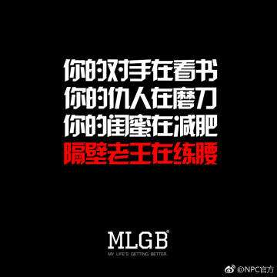
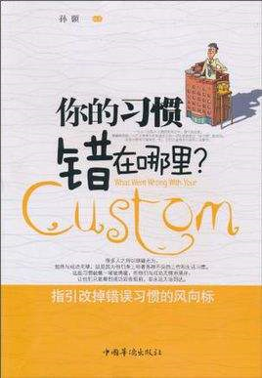
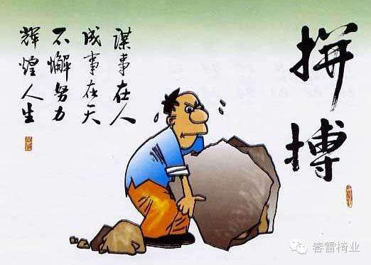

Slide 6
The Change Process
The Calm Waters Metaphor
  Lewin’s description of the change process as a break in the organization’s equilibrium state.
    Unfreezing the status quo
    Changing to a new state
    Refreezing to make the change permanent
White-Water Rapids Metaphor
  The lack of environmental stability and predictability requires that managers and organizations continually adapt (manage change actively) to survive.

Slide 7
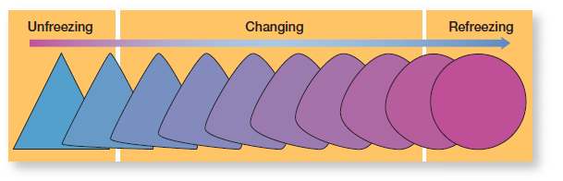
Exhibit 6-2: The Three-Step Change Process

Slide 8
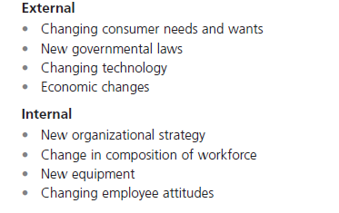
Exhibit 6-1: External and Internal
Forces for Change

Slide 9
Organizational Change and
Change Agents
Organizational Change - any alterations in the people, structure, or technology of an organization.
Change Agents - persons who act as catalysts and assume the responsibility for managing the change process.

Slide 10
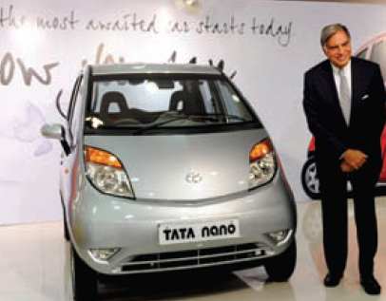
Types of Change Agents
Managers: internal entrepreneurs
Nonmanagers: change specialists
Outside consultants: change implementation experts

Slide 11
Types of Change
Structure
  Changing an organization’s structural components or its structural design
Technology
  Adopting new equipment, tools, or operating methods that displace old skills and require new ones
    Automation - replacing certain tasks done by people with machines
    Computerization
People
  Changing attitudes, expectations, perceptions, and behaviors of the workforce

Slide 12
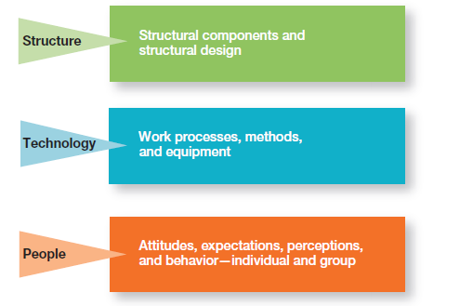
Exhibit 6-3: Three Types of Change

Slide 13
Organizational Development
Organizational Development (OD) - techniques or programs to change people and the nature and quality of interpersonal work relationships.
Global OD - OD techniques that work for U.S. organizations may be inappropriate in other countries and cultures.

Slide 14
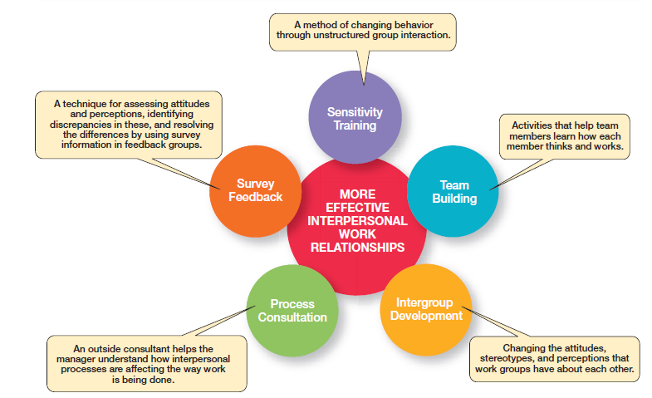
Exhibit 6-4: Popular OD Techniques

Slide 15
Managing Resistance to Change
Why People Resist Change
  The ambiguity and uncertainty that change introduces
  The comfort of old habits
  A concern over personal loss of status, money, authority, friendships, and personal convenience
  The perception that change is incompatible with the goals and interest of the organization

Slide 16
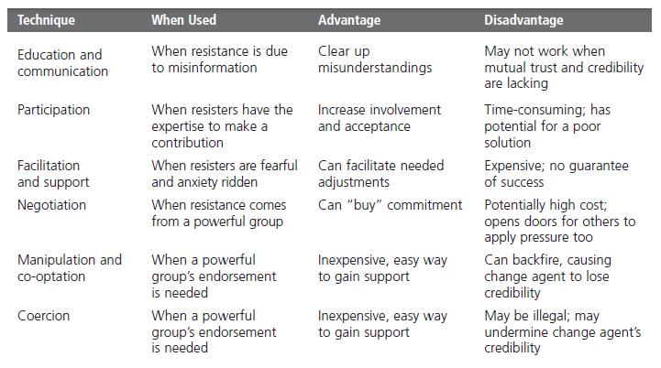
Exhibit 6-5: Techniques for Reducing
Resistance to Change

Slide 17
Changing Organizational Culture
Cultures are naturally resistant to change.
Conditions that facilitate cultural change:
  The occurrence of a dramatic crisis
  Leadership changing hands
  A young, flexible, and small organization
  A weak organizational culture

Slide 18
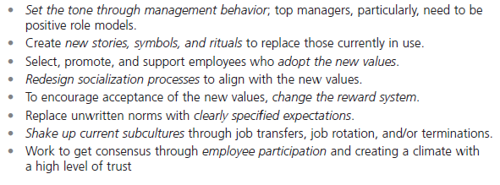
Exhibit 6-6: Changing Culture

Slide 19
Stress and Stressors
Stress - the adverse reaction people have to excessive pressure placed on them from extraordinary demands, constraints, or opportunities.
Stressors - factors that cause stress.

Slide 20
What Causes Stress?
Role Conflicts - work expectations that are hard to satisfy.
Role Overload - having more work to accomplish than time permits.
Role Ambiguity - when role expectations are not clearly understood.

Slide 21
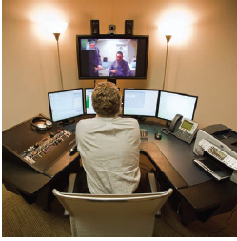
Personal Factors Causing Stress
Type A personality - people who have a chronic sense of urgency and an excessive competitive drive.
Type B personality - people who are relaxed and easygoing and accept change easily.

Slide 22
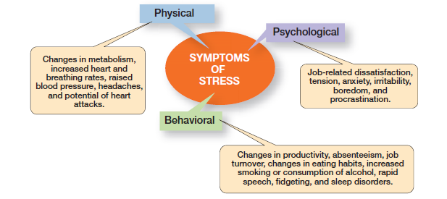
Exhibit 6-7: Symptoms of Stress

Slide 23
Stimulating Innovation
Creativity - the ability to combine ideas in a unique way or to make an unusual association.
Innovation - turning the outcomes of the creative process into useful products, services, or work methods.

Slide 24
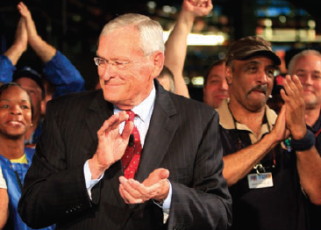
Stimulating Innovation (cont.)
Idea Champions - individuals who actively and enthusiastically support new ideas, build support, overcome resistance, and ensure that innovations are implemented.

Slide 25
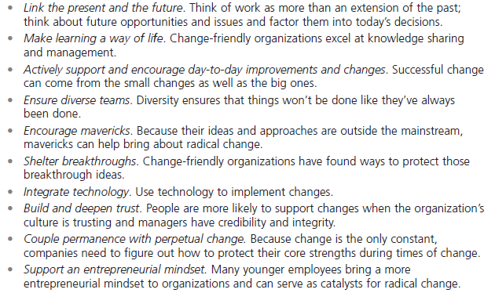
Exhibit 6-8: Change-Capable Organizations

Slide 26
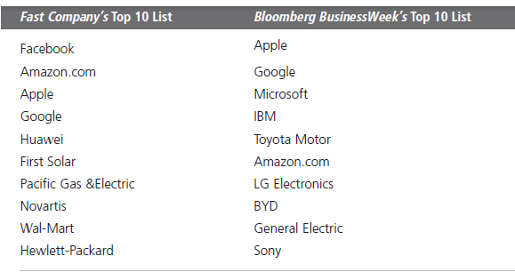
Exhibit 6-9: World’s Most
Innovative Companies

Slide 27
Structural Variables
Adopt an organic structure
Make available plentiful resources
Engage in frequent inter-unit communication
Minimize extreme time pressures on creative activities
Provide explicit support for creativity

Slide 28
Cultural Variables
Accept ambiguity
Tolerate the impractical
Have low external controls
Tolerate risk taking
Tolerate conflict
Focus on ends rather than means
Develop an open-system focus
Provide positive feedback

Slide 29
Human Resource Variables
Actively promote training and development to keep employees’ skills current
Offer high job security to encourage risk taking
Encourage individuals to be “champions” of change

Slide 30
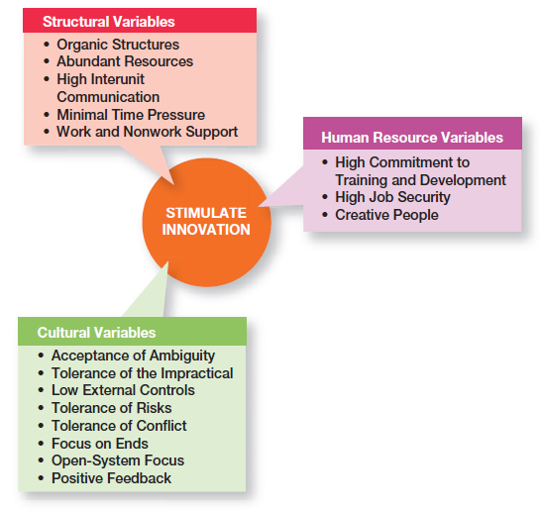
Exhibit 6-10: Innovation Variables

Slide 31
Terms to Know
organizational change
change agent
organizational development (OD)
stress
creativity
innovation
idea champion

Slide 32
